Slide 1

Team Name: AvvarI for Bharat
Team Leader Name: Manjunath Venkata Avvari
Problem Statement: Build an AI-powered solution that supports rural ecosystems, sustainability, or resource-efficient systems.

Slide 2

Brief about the Idea:
Heritage Lens AI: Digitizing India’s Cultural Legacy
The Vision: Transforming silent stones into storytellers by providing pilgrims with an AI-powered multimedia experience at heritage sites like Lepakshi Temple through simple QR code interaction.
Core Pillars
Instant Access: Scan QR codes on pillars or statues to unlock deep historical and mythological insights without physical guides.
Multimodal Delivery: AI-generated cinematic videos, architectural infographics, and high-quality audio narrations.
Inclusivity & Language: Real-time, multilingual support in Telugu, Hindi, and English to serve diverse domestic and global visitors.
Interactive Learning: A GenAI Assistant allows visitors to ask follow-up questions about specific artifacts using natural language.

Slide 3
Your solution should be able to explain the following:
How different is it from any of the other existing ideas?
          Multimedia Integration over Static Text: Unlike typical QR code implementations that merely lead to a Wikipedia page or a static PDF, this solution delivers AI-generated cinematic videos and natural-sounding audio narrations specifically tailored to the artifact being viewed.
How will it be able to solve the problem?
Eliminating Information Gaps: It provides high-quality historical context in areas where physical guides may be unavailable, unaffordable, or lack deep specialized knowledge.
USP of the proposed solution
"The Living Stone" Experience: Our USP is the Heritage AI Assistant. It transforms a physical scan into a two-way conversation, allowing the pilgrim to ask, "Why does this specific pillar hang?" and receive an instant, accurate answer based on verified historical data.

Slide 4
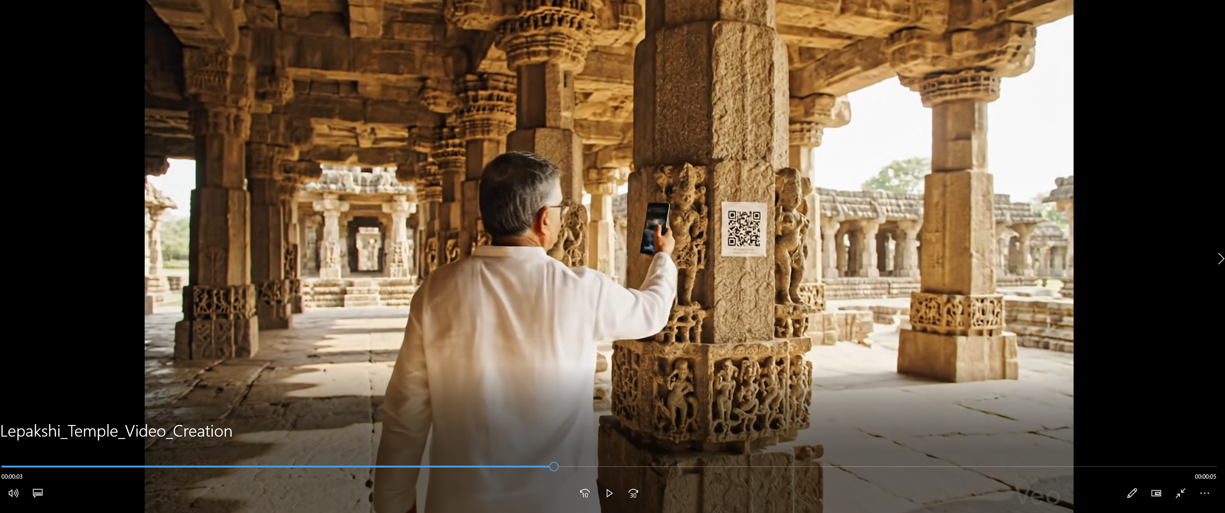
List of features offered by the solution

Slide 5
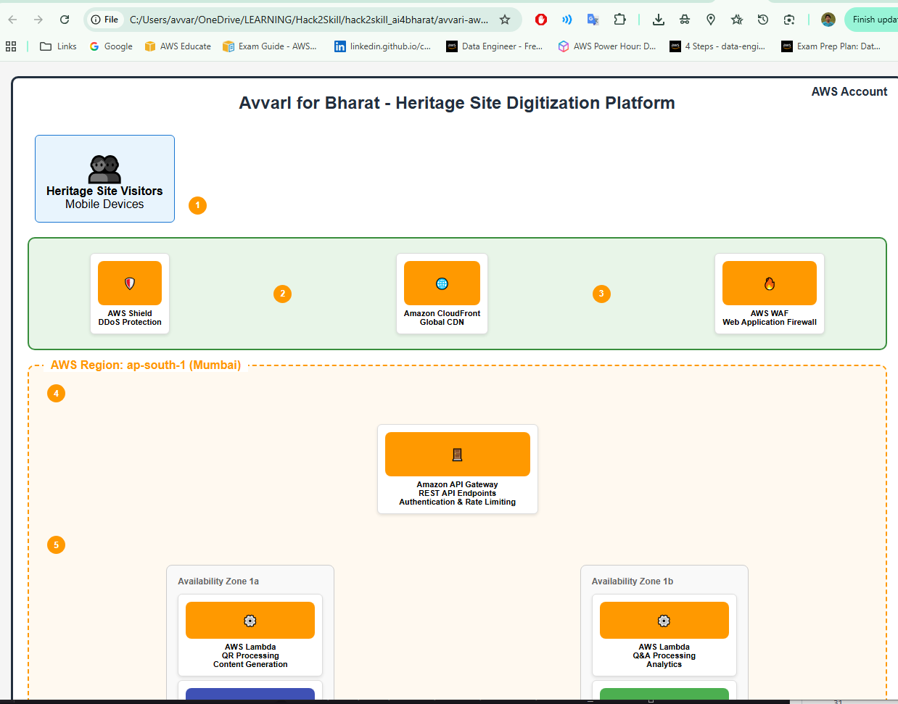
Process flow diagram or Use-case diagram
https://github.com/avvarimanju/hack2skill_ai4bharat/blob/main/avvari-aws-architecture.html

Slide 6
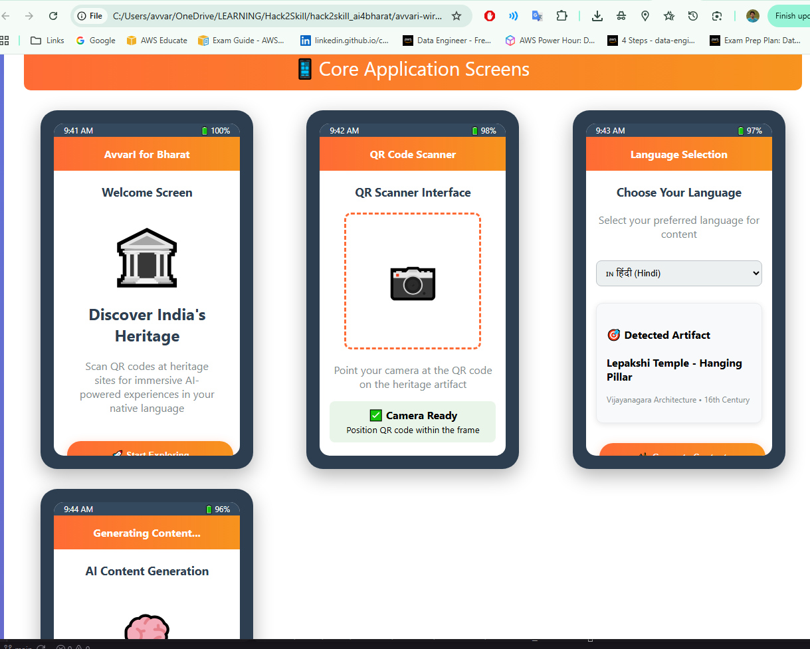
Wireframes/Mock diagrams of the proposed solution (optional)
https://github.com/avvarimanju/hack2skill_ai4bharat/blob/main/avvari-wireframes-mockups.html

Slide 7
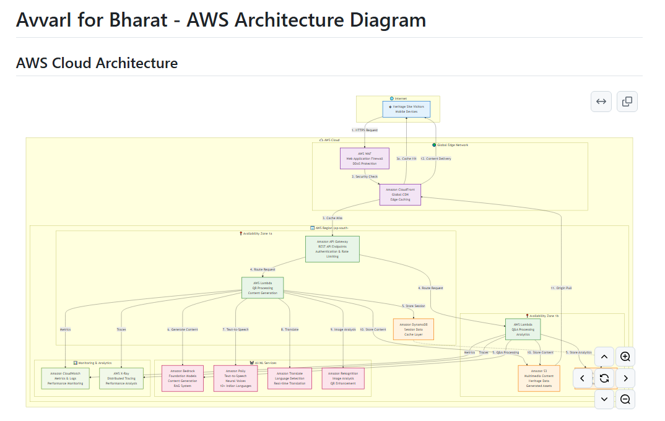
Architecture diagram of the proposed solution:
https://github.com/avvarimanju/hack2skill_ai4bharat/blob/main/avvari-architecture-diagram.md

Slide 8
Technologies to be used in the solution:
Project Vision: Transforming silent temple artifacts into interactive storytellers through an AI-powered multimedia platform for pilgrims.
Core Interaction: Visitors scan strategic QR codes on sculptures (Shilpams), pillars, and statues to unlock instant digital context.
Multimedia Delivery: Provides a coordinated suite of AI-generated cinematic videos, architectural infographics, and detailed audio guides.
Language Inclusivity: Features high-fidelity audio narrations in regional Indian languages (e.g., Telugu, Hindi) and English via Amazon Polly.
GenAI Heritage Assistant: A conversational chatbot powered by Amazon Bedrock allows visitors to ask real-time, deep-dive questions.
Problem Solved: Democratizes expert historical knowledge at rural sites where specialized human guides are unavailable or expensive.
Key Differentiator: Unlike static QR codes, this uses RAG (Retrieval-Augmented Generation) to provide dynamic, verified, and interactive responses.
The Tech Stack: Built on a robust AWS serverless architecture including Lambda, DynamoDB, S3, and Amazon Bedrock.
Rural Innovation: Boosts local tourism economies by making remote heritage sites globally accessible through scalable technology.
Sustainable Impact: Creates a digital archive of oral histories and temple legends, preserving Bharat's cultural soul for future generations.

Slide 9
Estimated implementation cost (optional):

Slide 10
Add as per the requirements for the hackathon:
Vision: Transforms silent heritage artifacts into interactive storytellers through a multimodal, AI-powered platform for pilgrims and tourists.
Language Inclusivity: Provides natural-sounding, multilingual narrations in regional vernaculars (e.g., Telugu, Hindi) and English via Amazon Polly.
GenAI Heritage Assistant: Features a conversational chatbot powered by Amazon Bedrock for real-time, interactive deep-dives into artifact history.

Slide 11


